Slide 1

Student Branch Chapter @ USF
Arcade Game on PyGame Zero
Software Lead: Zarina

Slide 2
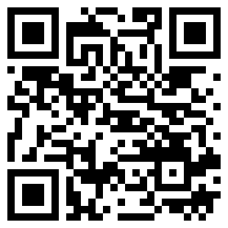

Check in! Support us

Slide 3

Follow Us
Discord
LinkedIn
Instagram
Bulls Connect
GitHub

Slide 4
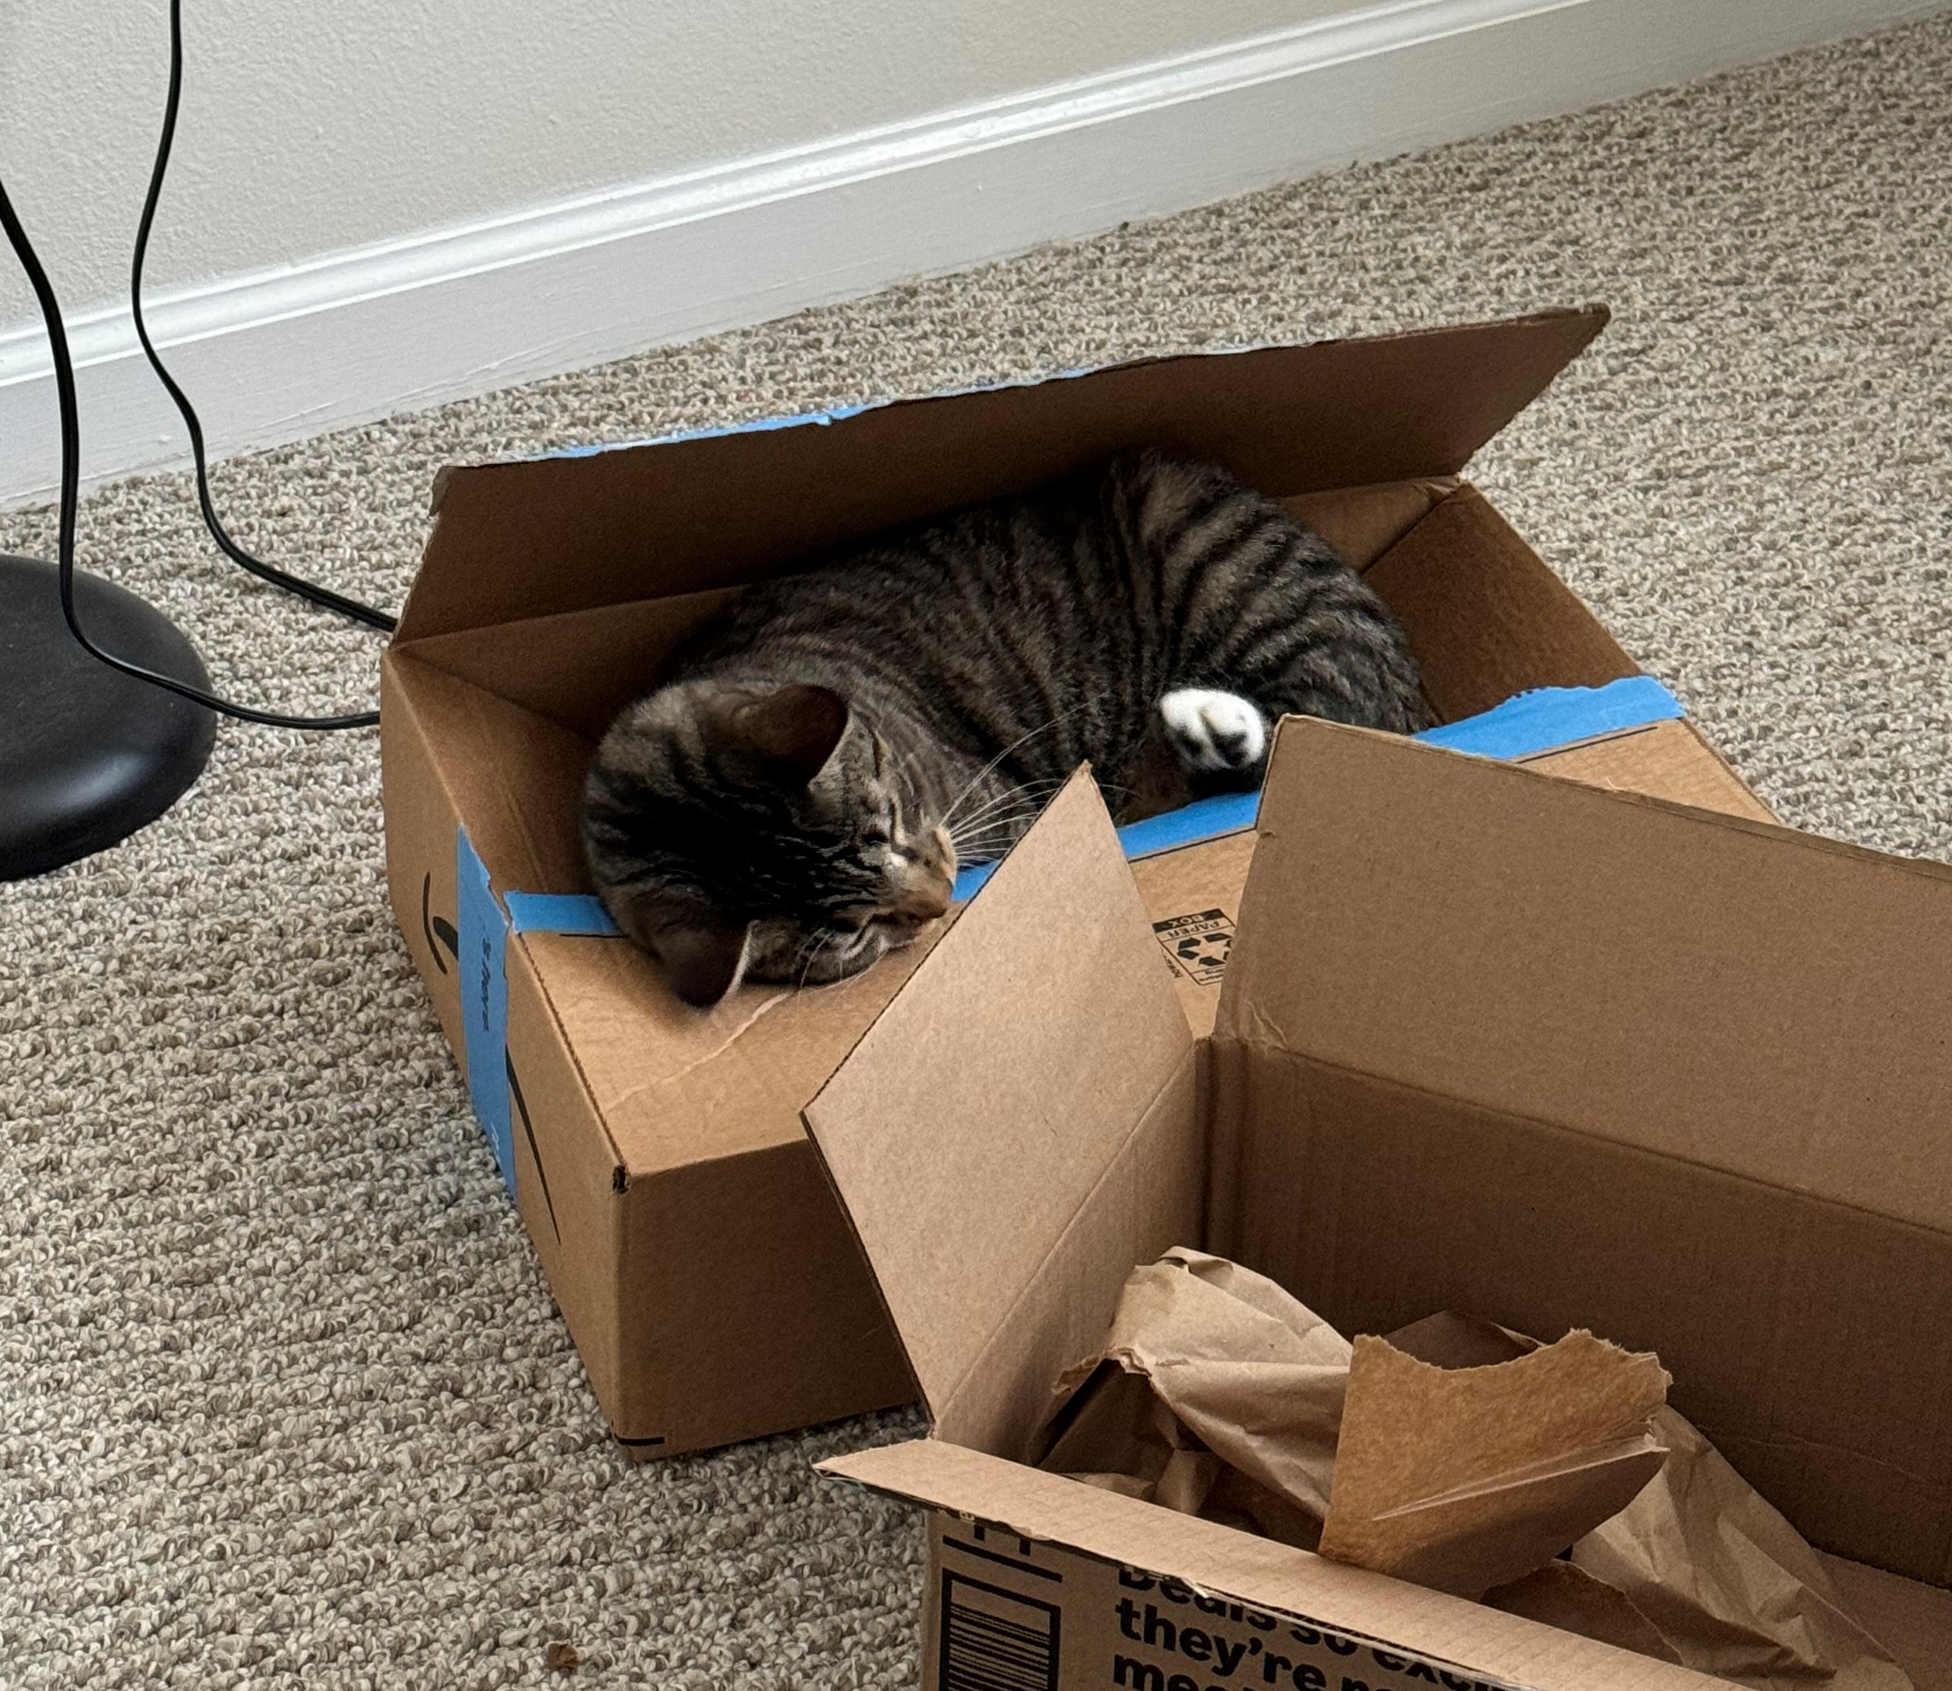
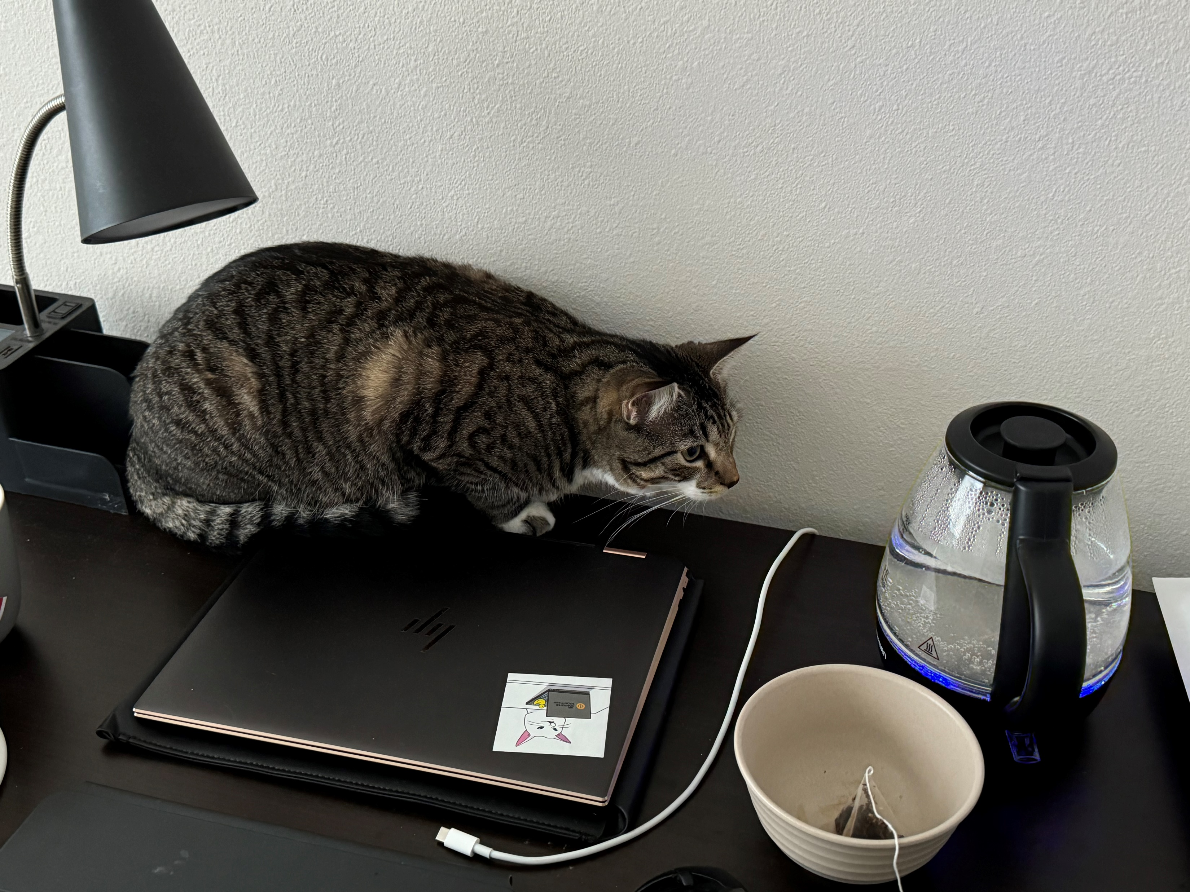
Enjoying Food and Photos of My Roommate’s Cat

Slide 5
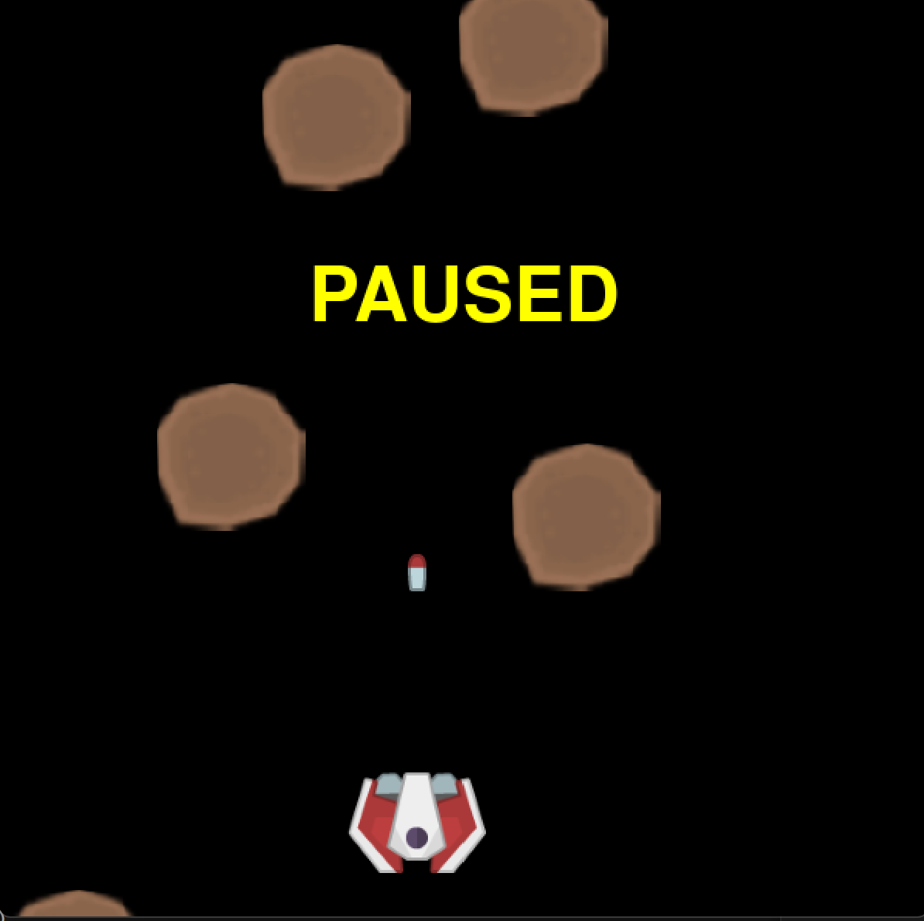
What are we building today?
Today we will create a space-themed game using Python and PyGame Zero.
We will involve the following functions:
Sprites
Movements
Generating meteors and missiles
Scores
Game status

Slide 6
By the end of this workshop, you will learn/improve:
Basic programming concepts
Object-Oriented Programming
Game Development Concepts
Graphics and Animation
Problem-solving and Logical Thinking
User Experience (UX)

Slide 7
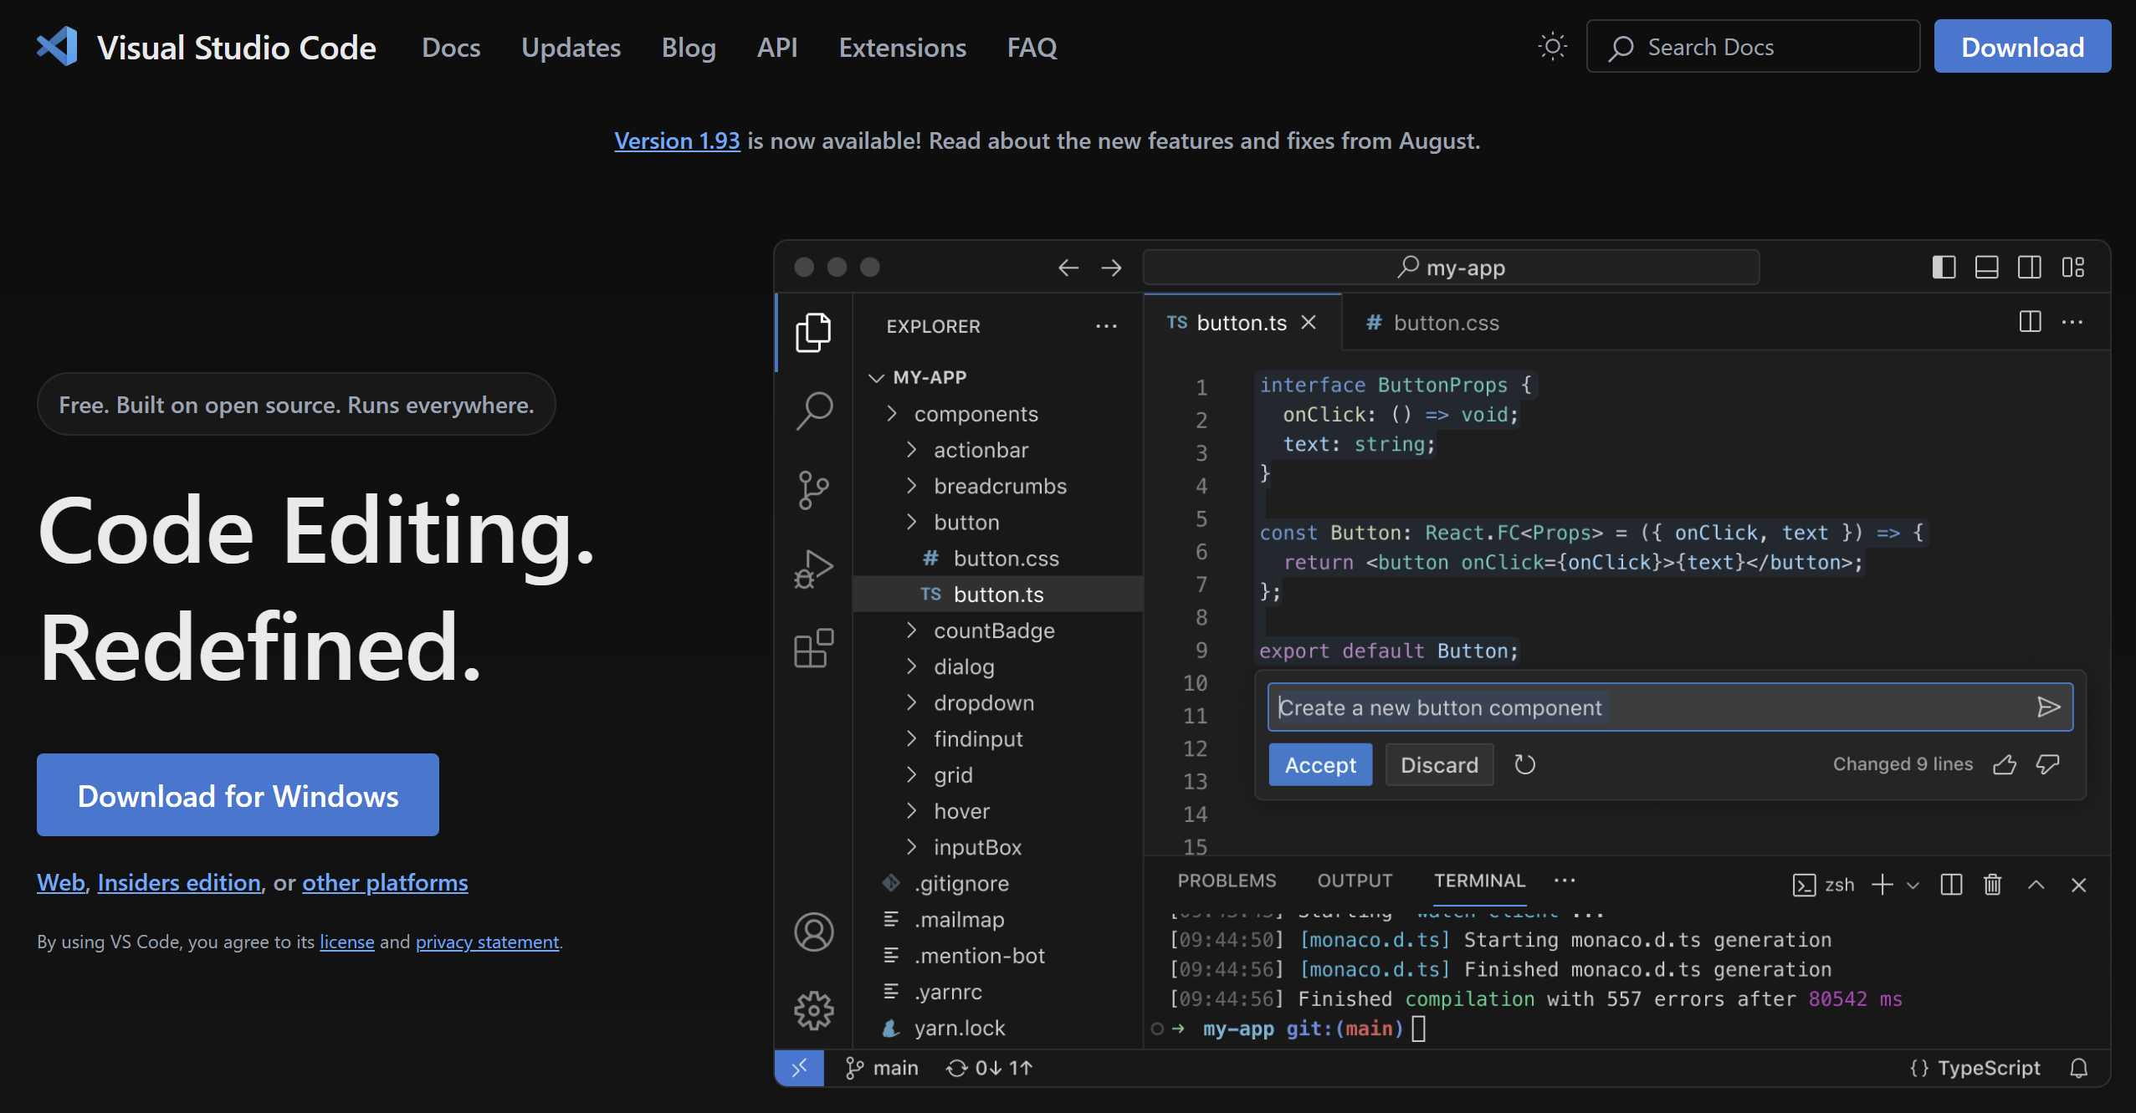
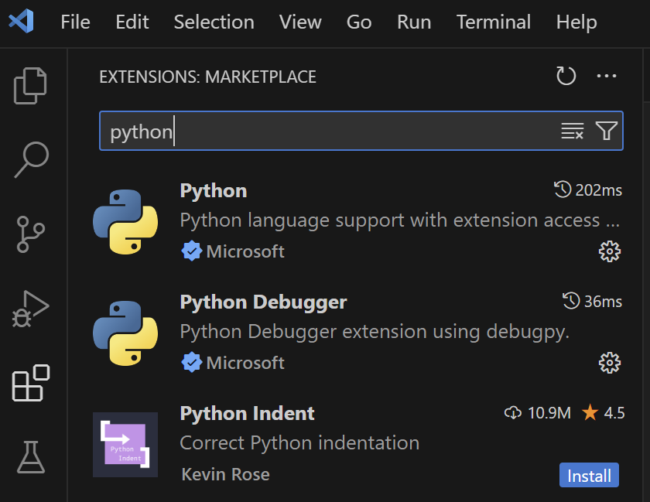
Setting up
For this workshop, we are going to use VS Code so I suggest downloading it. There we need to download Python and PyGame Zero

Slide 8
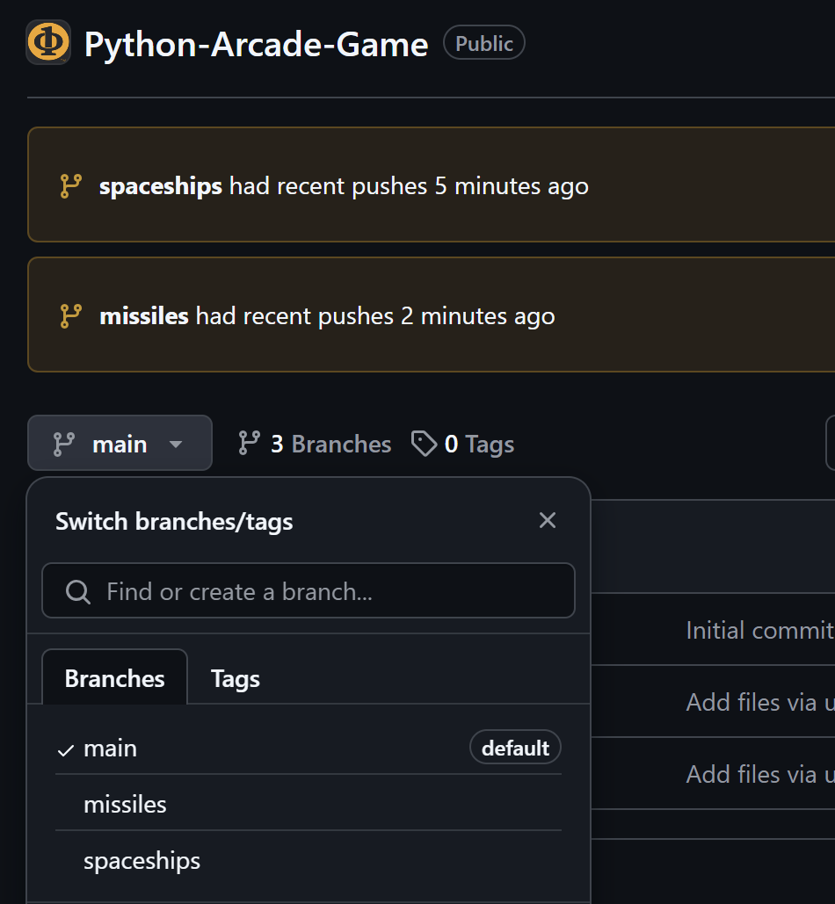
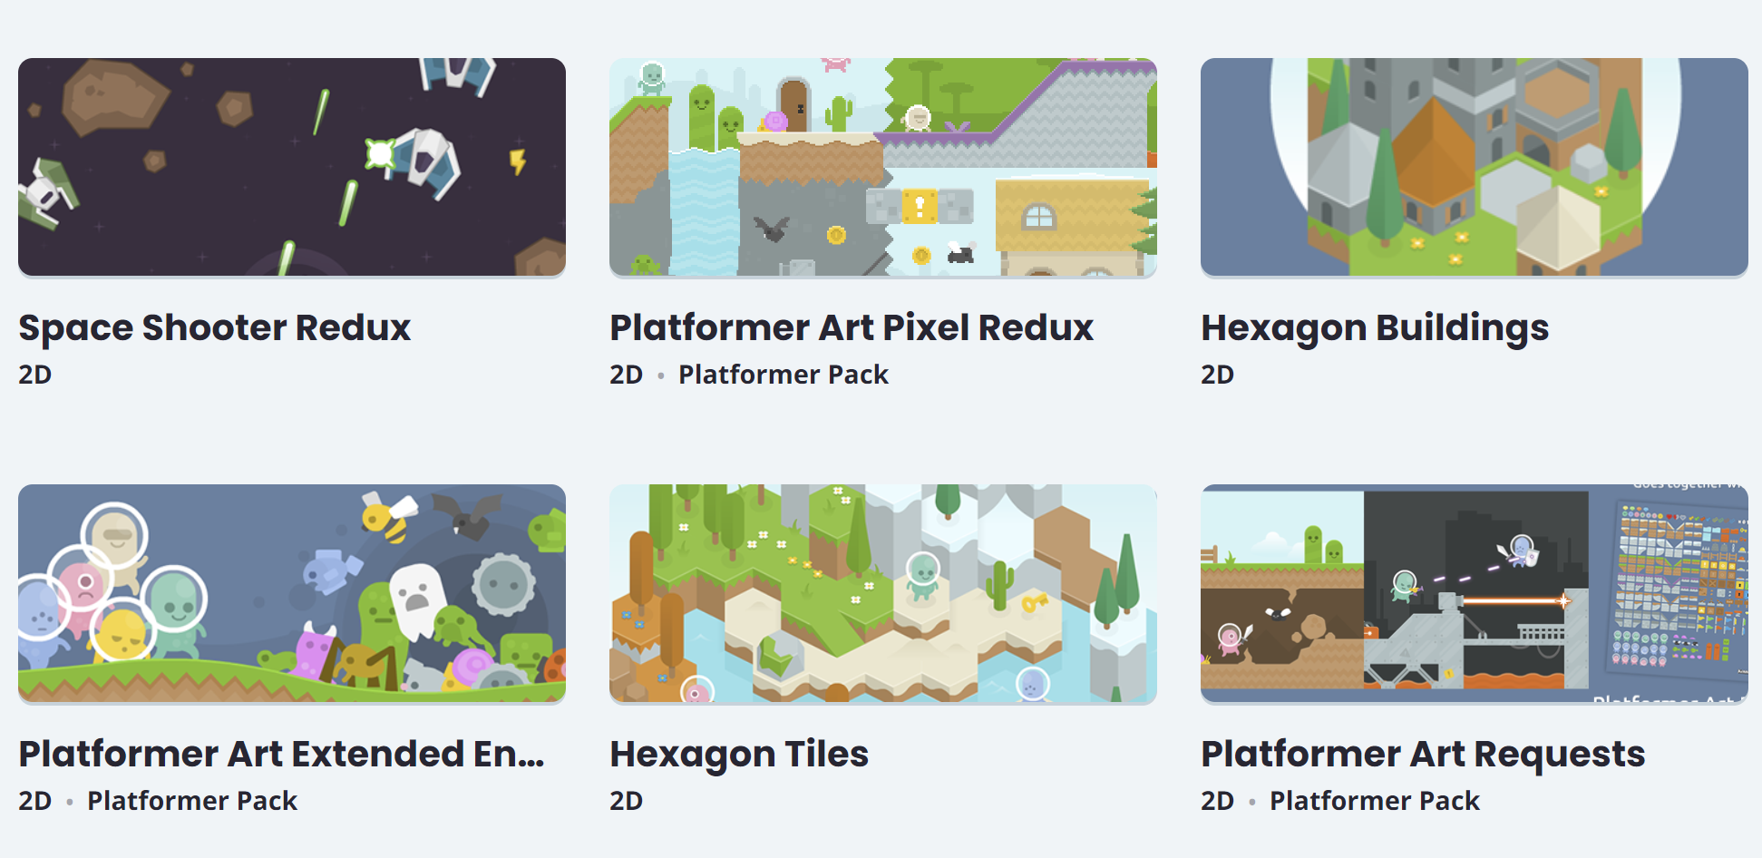
Setting up
Before we start we need to download the PyGameZero library and the images that we will use a sprite and other game objects. You can download the prepared ones from our GitHub.
The primary source is Kenney.nl

Slide 9
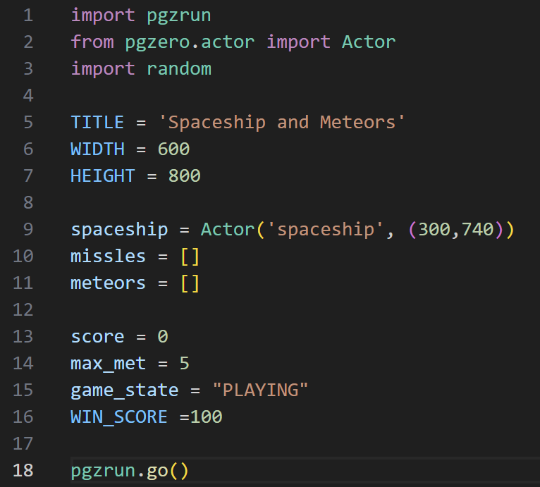
Let’s begin
There should be an explanation but I don’t think you need it here
It’s definitely not going to show us a black screen. Trust me

Slide 10
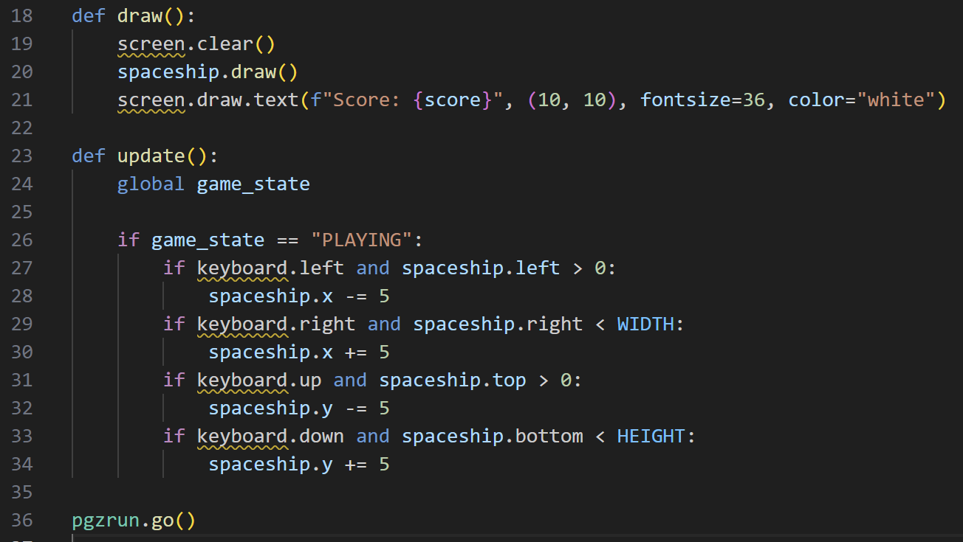

Oh, it did… Let’s make the spaceship visible

Slide 11

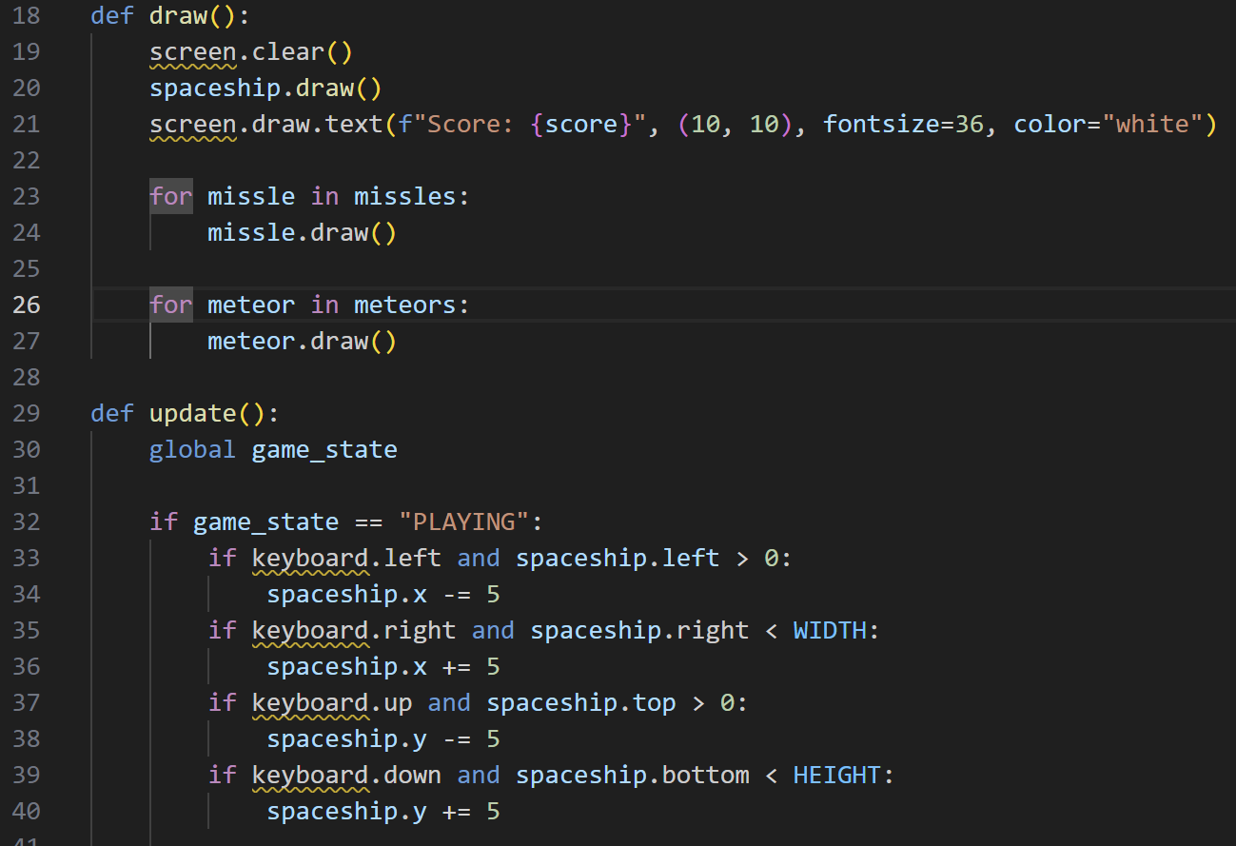
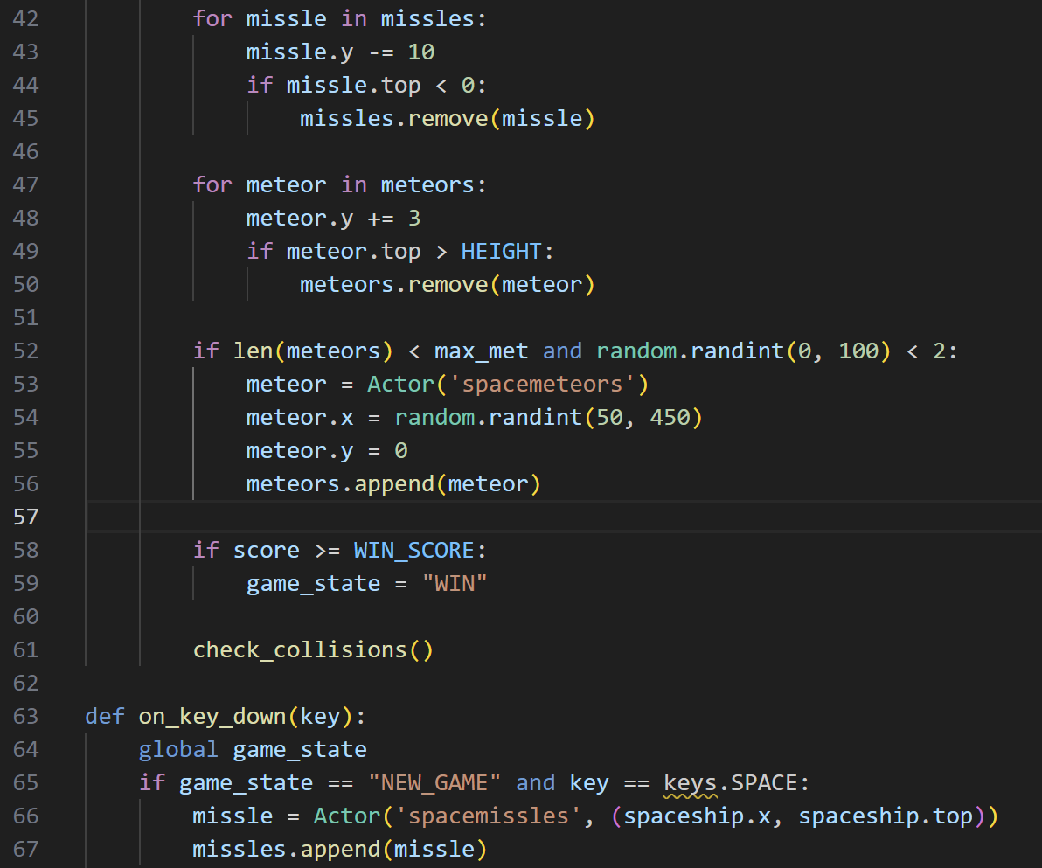
Adding other objects
Yes, we need to write all of that to have 2 objects and make them work

Slide 12
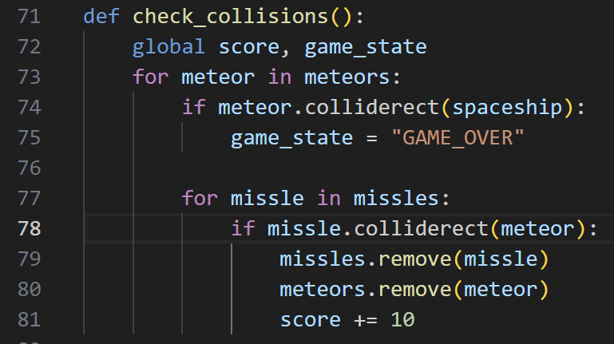
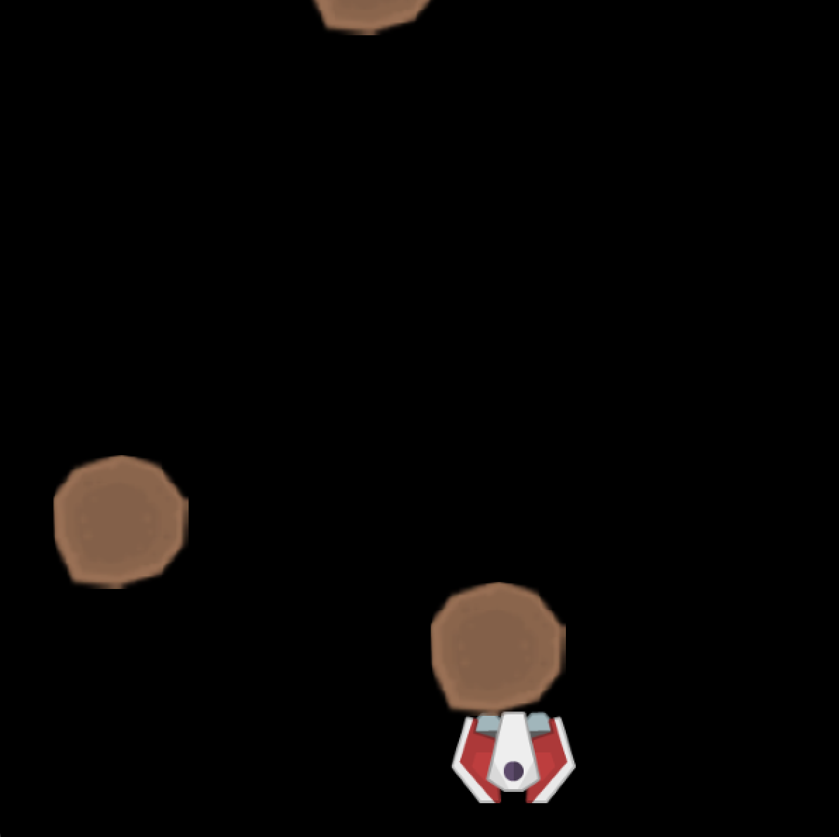
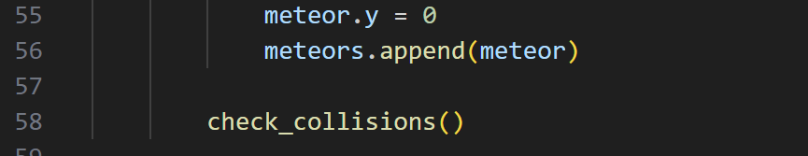
Collisions
Fortunately, the last slide was the biggest part. We need to put the check_collisions function inside the update function

Slide 13
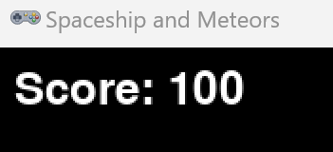
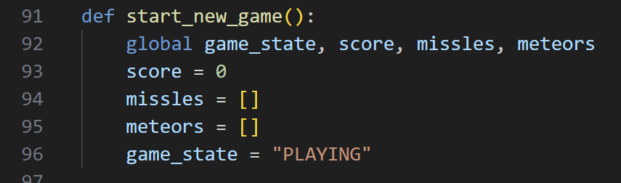
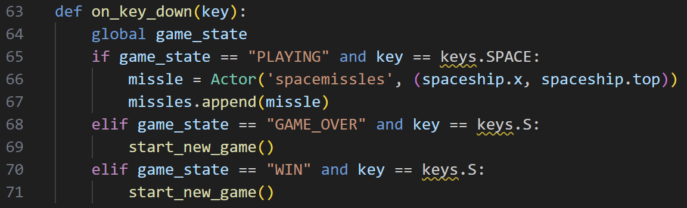
We won what’s next?
Probably, start a new one, because it is soooooo funny
The picture with the score is just for filling the space

Slide 14
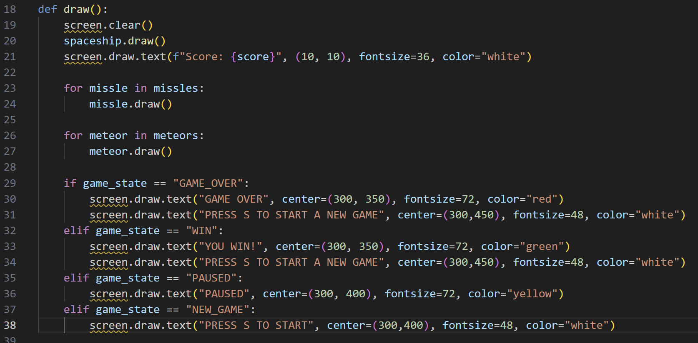
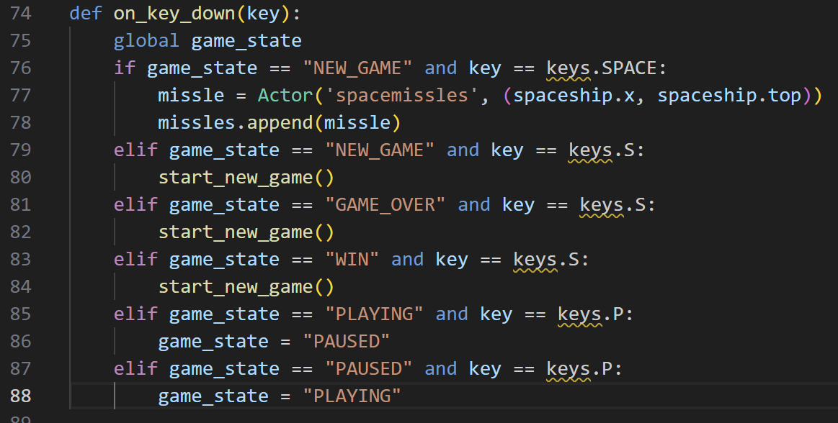
What about users?
To make players see what is going on we need to write a text with the function draw. Since I mentioned “PAUSE” in the text let’s add it

Slide 15
Let’s make some changes

Slide 16

Questions?

Slide 17
That’s a wrap, or is it?
SIMILAR PROJECTS YOU CAN BUILD
Snake game
Flappy bird
Platform Game (Jumping)
Etc.
There are a lot of games that you can try to make.
Also, you can continue developing this one by adding music, sound effects, animations, and whatever will come to your mind

Slide 18
Your action items + Next workshop ☺ !
Actions Items:
Upload your learnings today on LinkedIn and resume
Drop your suggestions in the poll
Make sure to network with folks around you
And join us in our next workshop

Slide 19

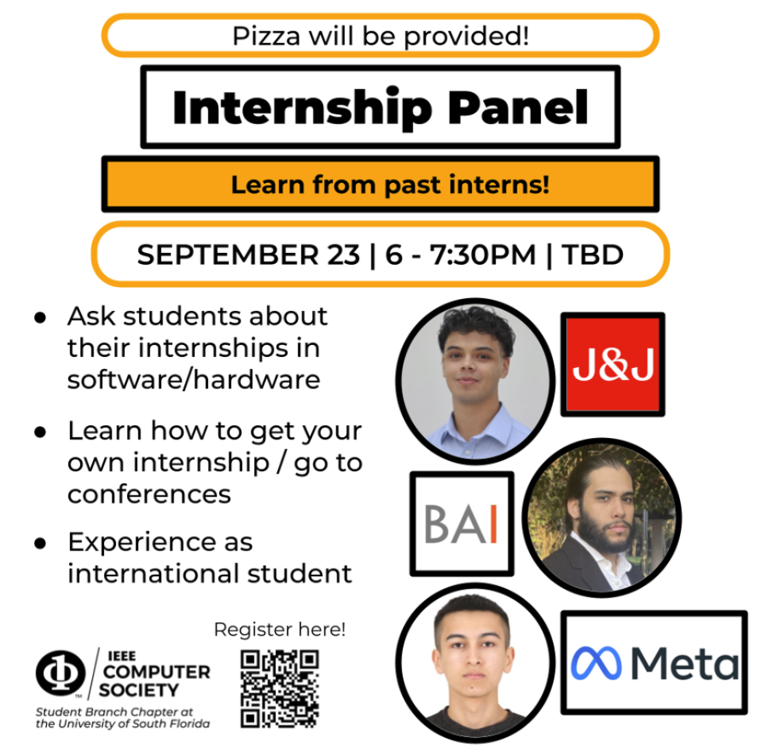
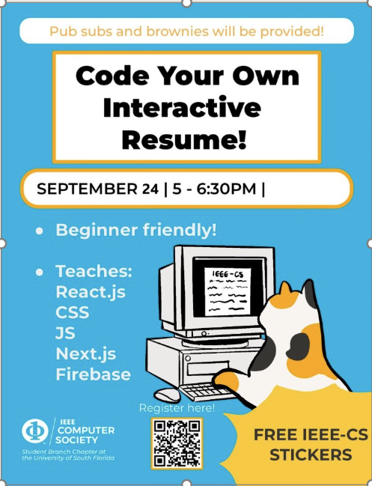
Next workshops ☺ !

Slide 20

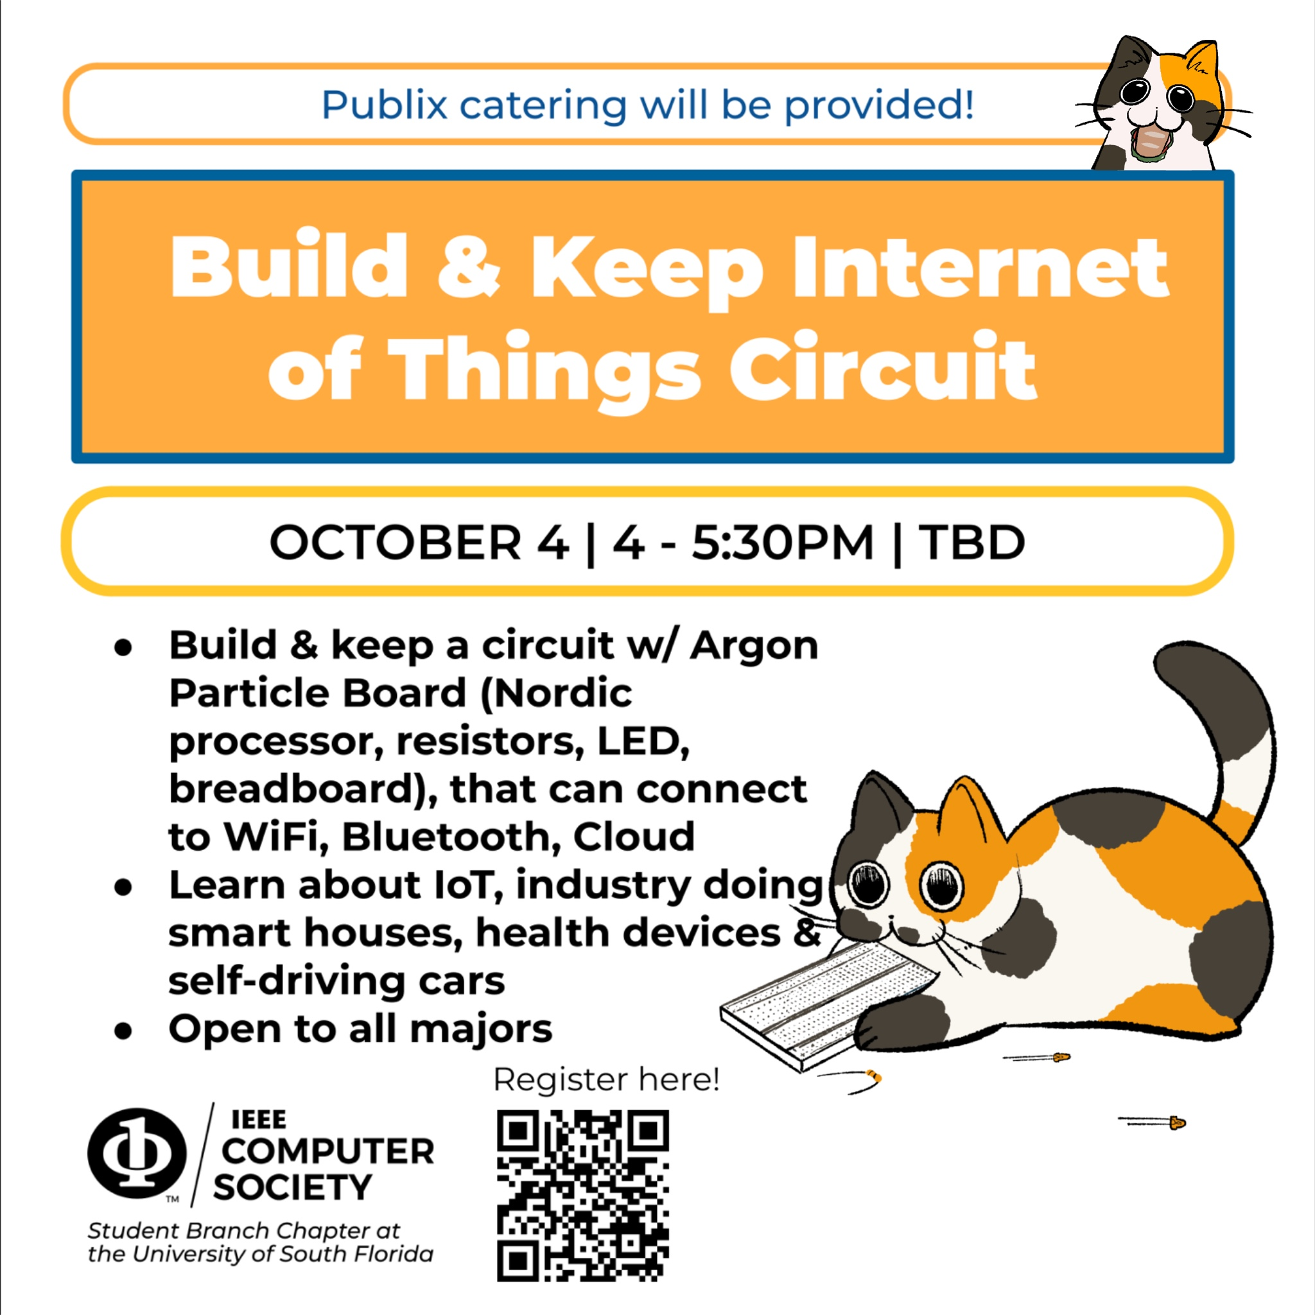
Next workshops ☺ !

Slide 21

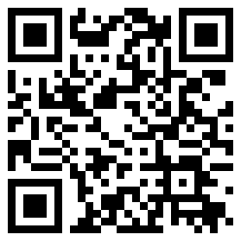
Next workshops ☺ !
October 9 5pm-6:30pm
Introduction to SQL Databases
No flyer but taught by Zarina :D

